Slide 1
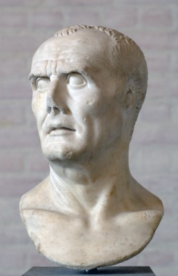
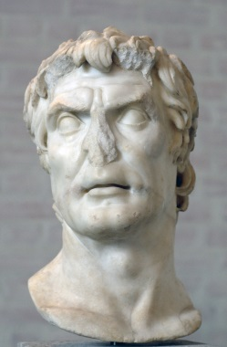
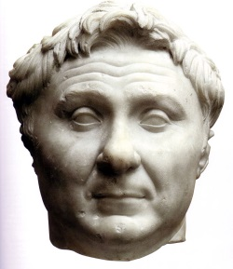
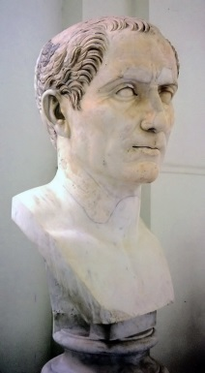
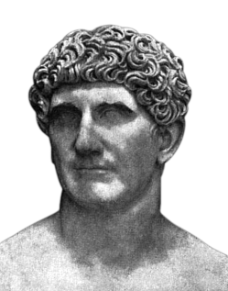
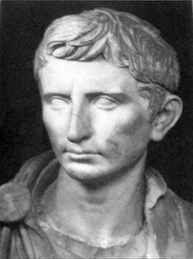
Civil Wars
Marius
Sulla
Pompey
Julius Caesar
Mark Antony
Octavian

Slide 2
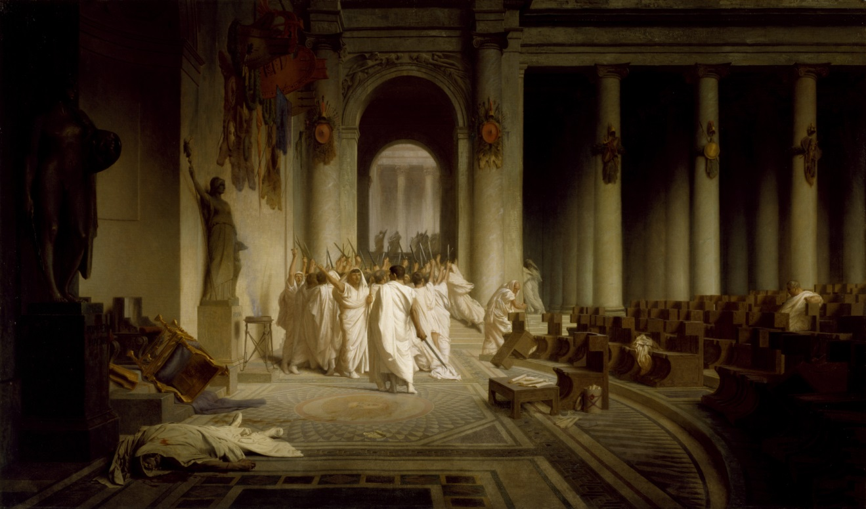
The Death of Caesar Ides of March, 44 bce

Slide 3
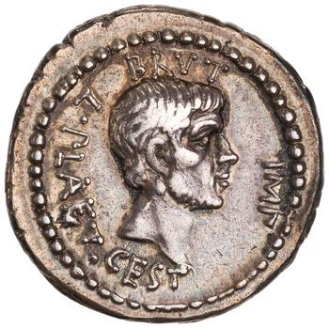
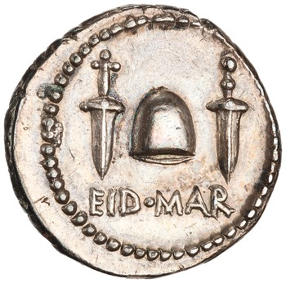
Brutus
*
Silver denarius, Greece(?), c. 43-42 BCE; obv.: head of Brutus r.; legend: BRVT[us] IMP[erator] L. PLAET[us] CEST[us]; rev.: freedman’s cap between daggers; legend: EID MAR (the ides of March)

Slide 4
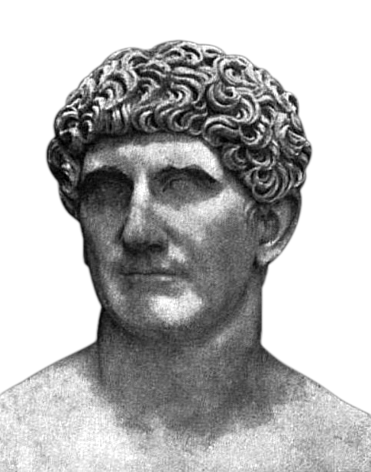
Mark Antony
Marcus Antonius
c. 83-30 BCE
Military career, including in Gaul under Caesar
Quaestor in 52, augur in 50, tribune of the plebs in 49
Supported Caesar’s invasion of Italy and served as his deputy
Made consul in 44
Delivered a funeral oration for Caesar that roused the people of Rome against the assassins

Slide 5

Octavian
63 BCE-14 CE
Born Gaius Octavius
Grand nephew of Julius Caesar
Fought with Caesar against Sextus Pompey in Spain
Upon Caesar’s death he accepted inheritance of his will, and therefore the onus to avenge his killing
And his name
Hence ‘Gaius Julius Caesar Octavianus’

Slide 6

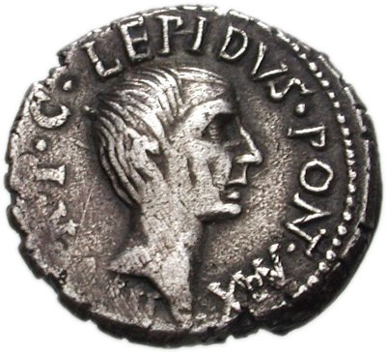
The Second Triumvirate

Slide 7
The Second Triumvirate
Essentially a three-person dictatorship, effective for five years
Officially the ‘committee of three for the organization of the state’
Empowered to eliminate Caesar’s murderers
Control over elections
Antony and Octavian assigned to fight the war in the east; Lepidus given management of affairs in Italy
Empowered to proscribe political enemies in Rome

Slide 8
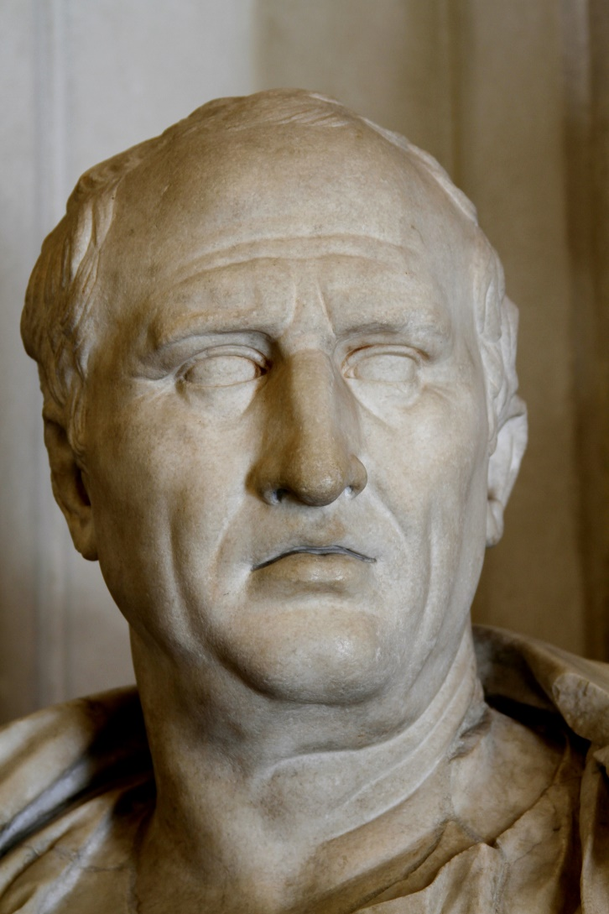
…including Cicero
Had attacked Antony in the First and Second Philippic
Proscribed by the Second Triumvirate
Tried to escape to Macedonia, but was murdered late in 43 BCE
Head and hands were nailed to the rostra in Rome

Slide 9
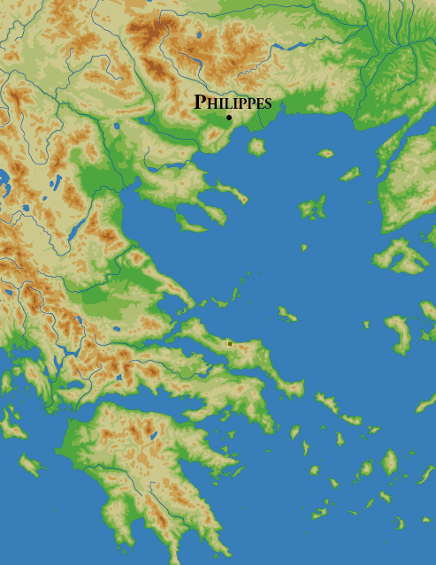
Philippi (42 bce)
Brutus, Cassius and other optimates fled to Greece after the death of Caesar
Took control of the Roman legions there and collected taxes
Antony and Octavian crossed over to Greece in 42 BCE
Brutus and Cassius were defeated in two battles at Philippi and committed suicide afterwards

Slide 10
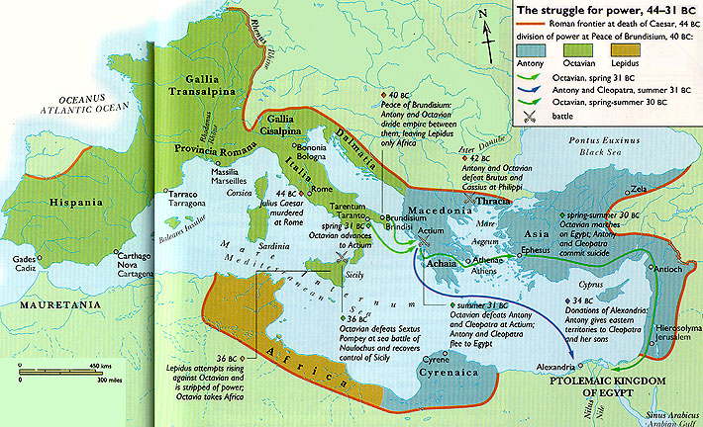


Division of Provinces

Slide 11
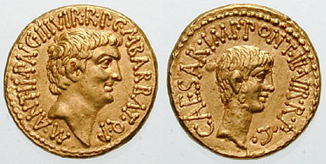
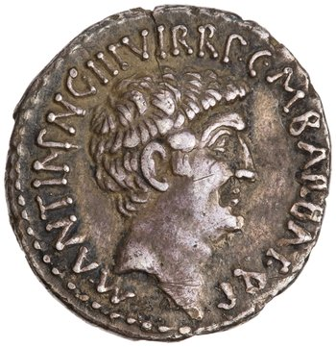
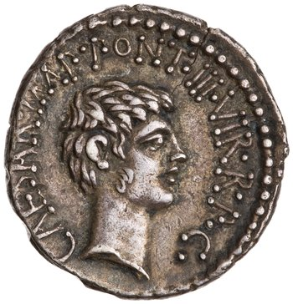
The Second Triumvirate
Gold aureus, mobile mint, c. 41 BCE; obv.: head of Mark Antony r.; legend: M ANT[ony] IMP[erator] AVG[ustus] III VIR R P C M BARBAT[us] Q P; rev.: head of Octavian r.; legend: CAES[ar] IMP[erator] PONT III VIR R P C
Silver denarius, mobile mint, c. 41 obv.: head of Mark Antony r.; legend: M ANT[ony] IMP[erator] AVG[ustus] III VIR R P C M BARBAT[us] Q P; rev.: head of Octavian r.; legend: CAES[ar] IMP[erator] PONT III VIR R P C

Slide 12
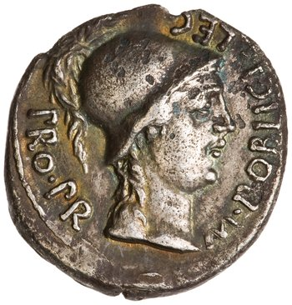
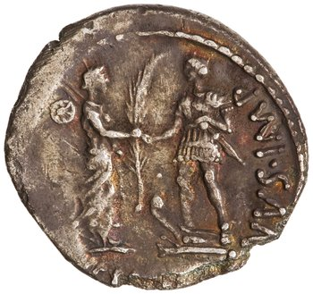
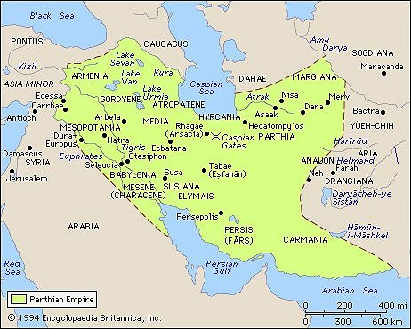
More Enemies
Sextus Pompeius
The Parthians
Silver denarius, Hispania, c. 46-45 BCE; obv.: helmeted head of Roma r.; legend: M POBLICI[us] LEG PRO PR; rev.: Hispania standing r. giving palm branch to soldier standing on prow of ship; legend: CN. [Pompey] MAGNVS (the great) IMP[erator]

Slide 13
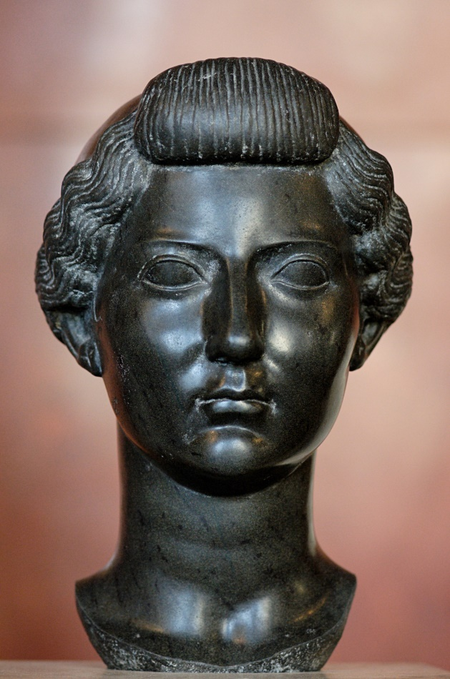
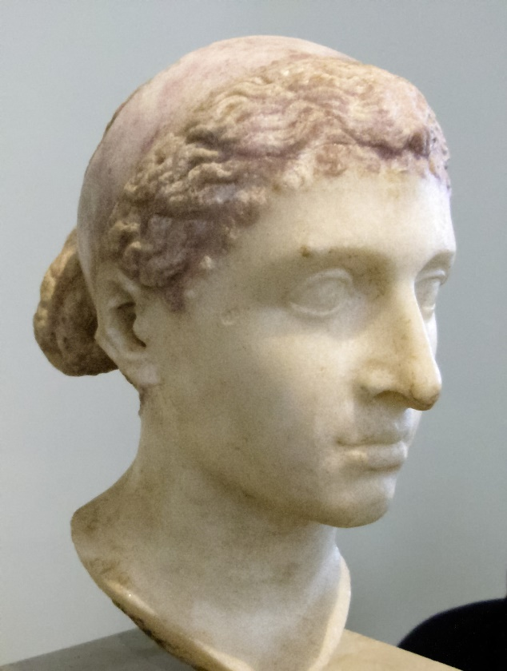
Livia and Cleopatra
Livia
Cleopatra

Slide 14

Cleopatra
Cleopatra VII
c. 69-30 BCE
Daughter of Ptolemy XII, sister and wife of Ptolemy XIII
Supported by Caesar against her brother in 48; they had a son, Ptolemy XV (aka ‘Caesarion’)
In 41 Antony spent the winter with her in Egypt; they had twins (Alexander Helios and Cleopatra Selene)

Slide 15

Livia
Livia Drusilla
c. 59 BCE-29 CE
From the patrician Claudian family
Married to Tiberius Claudius Nero, a supporter of Antony
Octavian and Livia married in 39, after divorcing both their spouses

Slide 16
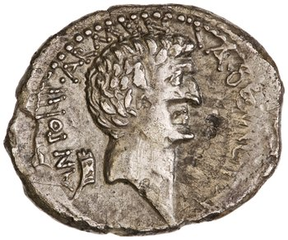
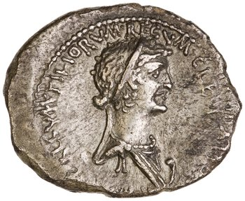
The Propaganda War
Antony
Octavian
Made Antony’s (supposed) will public, with the result that:
“This caused the Romans in their indignation to believe that the other reports in circulation were also true, to the effect that if Antony should prevail, he would bestow their city upon Cleopatra and transfer the seat of power to Egypt.”
- Cassius Dio 50.4.1
Silver denarius, Greece or Egypt(?), c. 32 BCE; obv.: head of Mark Antony r.; legend: [Mark] ANTONI ARMENIA DEVICTA (Armenia defeated); rev.: diademed head of Cleopatra r. over prow; legend: CLEOPATRAE REGINAE REGVM FILIORVM REGVM (to the kingdom of Queen Cleopatra and her royal children)

Slide 17
Actium (31 bce)

Slide 18
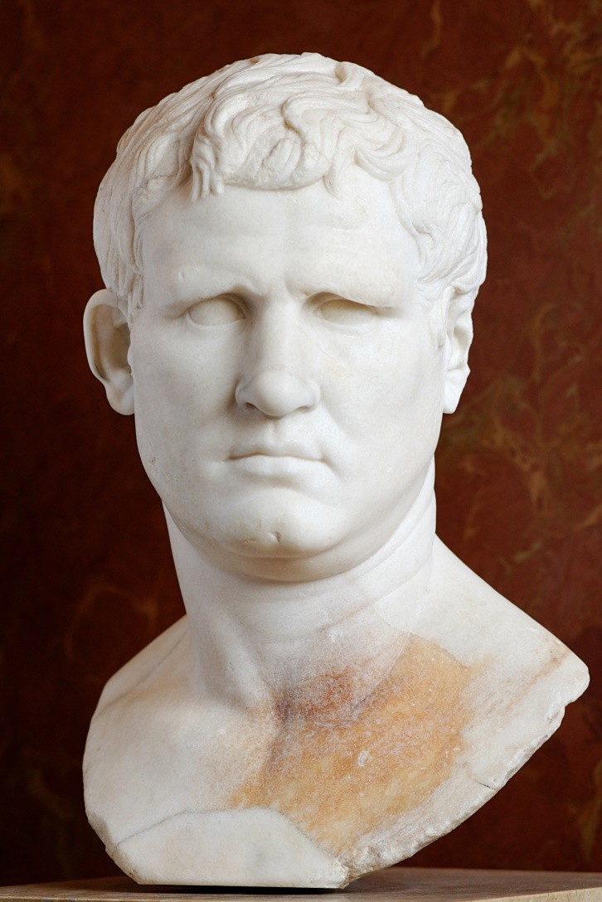
Agrippa
Marcus Vipsanius Agrippa
c. 64-12 BCE
Friend and henchman of Octavian
Naval genius who helped defeat Sextus Pompeius and win the battle of Actium
Responsible for a major construction program in Rome after the civil war

Slide 19
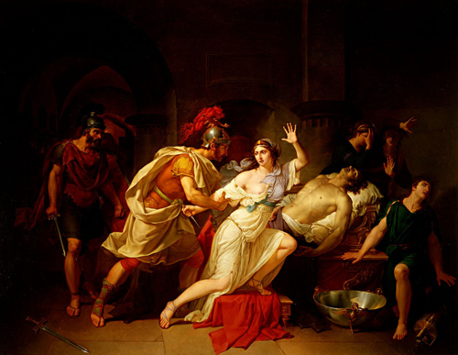
Death of Antony and Cleopatra
30 BCE

Slide 20
Octavian in Charge
Granted the title ‘Augustus’ (‘revered one’) in 27 BCE
Held one consulship every year from 27 to 23
Received proconsular imperium for ten years (extended for his entire life)
Included all provinces with legions
Other provinces he left to the Senate
After 23 he received consular and tribunician powers for life
Became ‘Princeps’ (‘first citizen’) and ‘Father of the Fatherland’

Slide 21
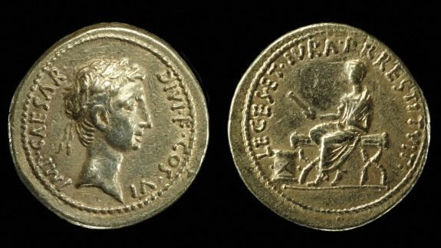
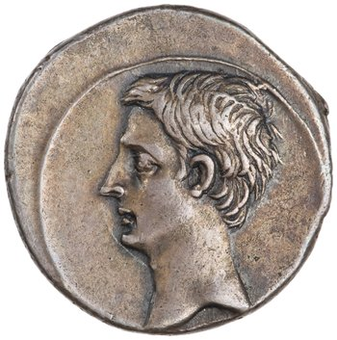
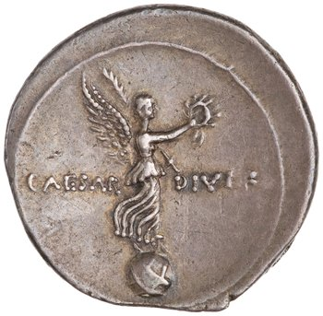
Octavian’s Coins
*
Gold aureus, unknown mint, c. 28 BCE; obv.: diademed head of Octavian r.; legend: IMP[erator] CAESAR DIVI F (son of the god) COS VI (six times consul); rev. Octavian, seated left on bench, holding scroll in right hand; legend: LEGES ET IVRA P RESTITVIT (‘He has restored to the people their laws and their rights’)
Silver denarius, Rome or Brundisium, Italy, c. 31-29 BCE; obv.: head of Octavian l.; rev.: Victory standing r. on a globe holding a wreath and palm; legend: CAESAR DIVI F (son of the god)

Slide 22
A Standing Army
“I paid the towns money for the fields which I had assigned to soldiers in my fourth consulate (30 B.C.E.) and then when Marcus Crassus and Gnaeus Lentulus Augur were consuls (14 B.C.E.); the sum was about HS 600,000,000 which I paid out for Italian estates, and about HS 260,000,000 which I paid for provincial fields. I was first and alone who did this among all who founded military colonies in Italy or the provinces according to the memory of my age.”
- Res Gestae Divi Augusti 16

Slide 23
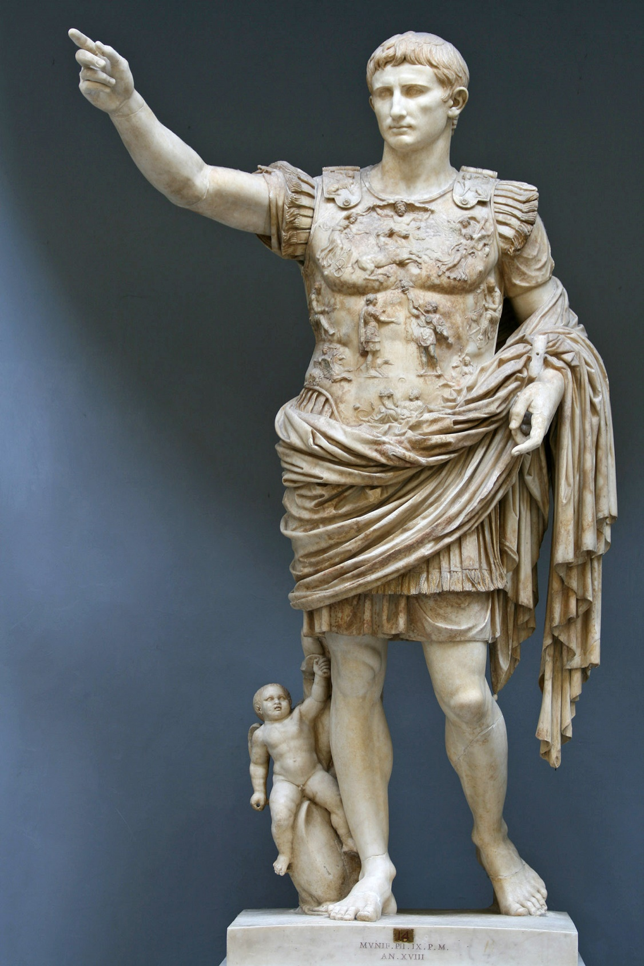
Augustus of Primaporta
Set up at Livia’s villa at Primaporta near Rome after Augustus’ death in 14 CE
Possibly a marble version of a bronze statue made during his lifetime
Originally painted
Youthful idealized portrait of Augustus
Greek posture
Orator’s gesture
Cuirass indicating military prowess
With an image of a Parthian returning the legionary standards to Roma
Bare feet indicate divine status

Slide 24
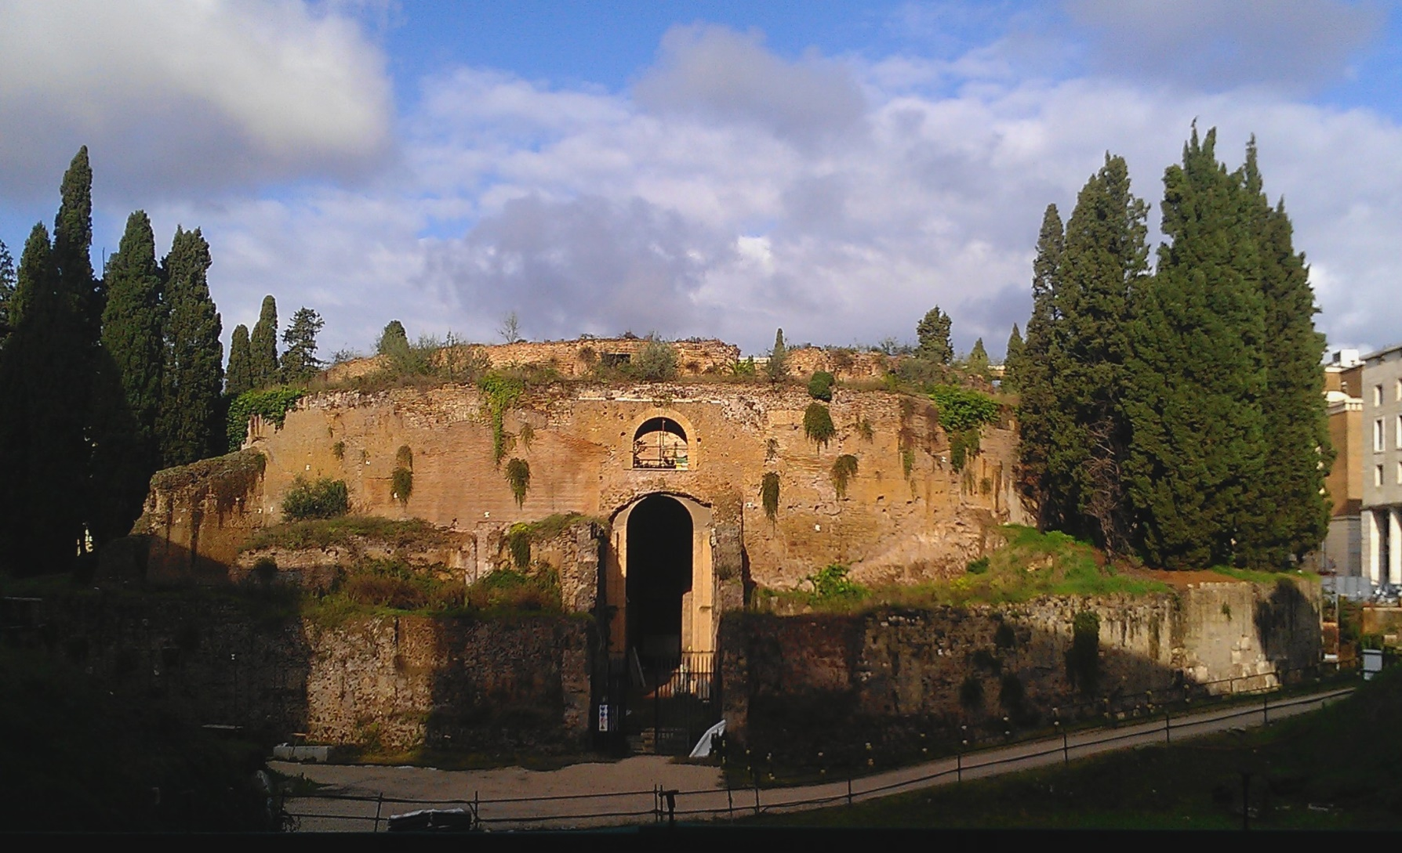
The Death of Augustus (14 ce)
Mausoleum of Augustus, Campus Martius, Rome

Slide 25
Res Gestae Divi Augusti
5. “When the dictatorship was offered to me, both in my presence and my absence, by the people and senate, when Marcus Marcellus and Lucius Arruntius were consuls (22 B.C.E.), I did not accept it. I did not evade the curatorship of grain in the height of the food shortage, which I so arranged that within a few days I freed the entire city from the present fear and danger by my own expense and administration. When the annual and perpetual consulate was then again offered to me, I did not accept it.”

Slide 26
Res Gestae Divi Augusti
13. “Our ancestors wanted Janus Quirinus to be closed when throughout the all the rule of the Roman people, by land and sea, peace had been secured through victory. Although before my birth it had been closed twice in all in recorded memory from the founding of the city, the senate voted three times in my principate that it be closed.”

Slide 27
The Last Word
“At home all was calm. The officials carried the older names; the younger men had been born after the victory of Actium; most even of the elder generation, during the civil wars; few indeed were left who had seen the republic.”
- Tacitus, Annals 1.3.7
*

Slide 28
Key Terms
Mark Antony
Octavian
Brutus
Philippi
Cleopatra
Livia
Actium
Res Gestae Divi Augusti

